Slide 1

Group Psychology and Group Psychotherapy Specialty Council
GPGP Specialty Council or GPGPSC or Specialty Council

Slide 2
Who?
Officers
Co-Sponsoring Specialty Organization Representatives
President –Noelle Lefforge
Vice-President – Vinny Dehili
Secretary – Kathryn White
Treasurer -Misha Bogomaz
Representative to Council of Specialties – Noelle Lefforge
Div 49 President – Amy Nitza
Div 49 Pres-Elect – Noelle Lefforge
AGPA President – Gary Burlingame
(Molyn Leszcz transitioning off)
AGPA Pres-Elect – Lorraine Wodiska
ABGP/ABPP President – Darryl Pure
IBCGP Chair – Steve Van Wagoner
ASGW Rep – Kendra Jackson
St. Elizabeth’s – Farooq Mohyuddin
Recruiting other organizations

Slide 3
What? Why? How?
GPGP Specialty Council Strategic Plan
Objectives
1. Assist training programs to review for the specialty
2. Increase visibility of specialty
3. Increase # of affiliated organizations
4. Resubmission tasks
5. GPGP Specialty Council

Slide 4
Specialty Petition
Resubmission due January 1, 2025
Overseen by APA Commission for the Recognition of Specialties and Subspecialties in Professional Psychology (CRSSPP) – then approved by APA Council of Representatives
“A specialty is a defined area of professional psychology practice characterized by a distinctive configuration of competent services for specified problems and populations. Practice in a specialty requires advanced knowledge and skills acquired through an organized sequence of formal education, training, and experience in addition to the broad and general education and core scientific and professional foundations acquired through an APA or CPA accredited doctoral program”

Slide 5
Specialty Petition
Governing Bodies
Governing Documents
APA Commission on Accreditation (CoA) – accrediting body of APA, accredits postdoctoral programs in the specialty
APA/ABPP Council of Specialties in Professional Psychology (CoS) – represents and supports the development and functioning of recognized specialties in Professional Psychology
A Taxonomy for Education and Training in Professional Psychology Health Service Specialties and Subspecialties - https://www.apa.org/ed/graduate/specialize/taxonomy.pdf
Standards of Accreditation for Health Service Psychology - https://www.apa.org/ed/accreditation/about/policies/standards-of-accreditation.pdf

Slide 6
Taxonomy
Establishes the criteria for recognition and maintenance of the specialty
APA recognizes specialties related to direct provision of health services and those that involved other aspects of applied professional service
  Taxonomy guidelines only apply to health service provision
  GPGP is unique because it captures specialization in health services and/or applied professional service
Establishes standardized language for training programs to use regarding specialty training
Does not prescribe training paths for students/specialists. Does not dictate how programs provide training.
In addition to general practice training
Does not regulate practice

Slide 7
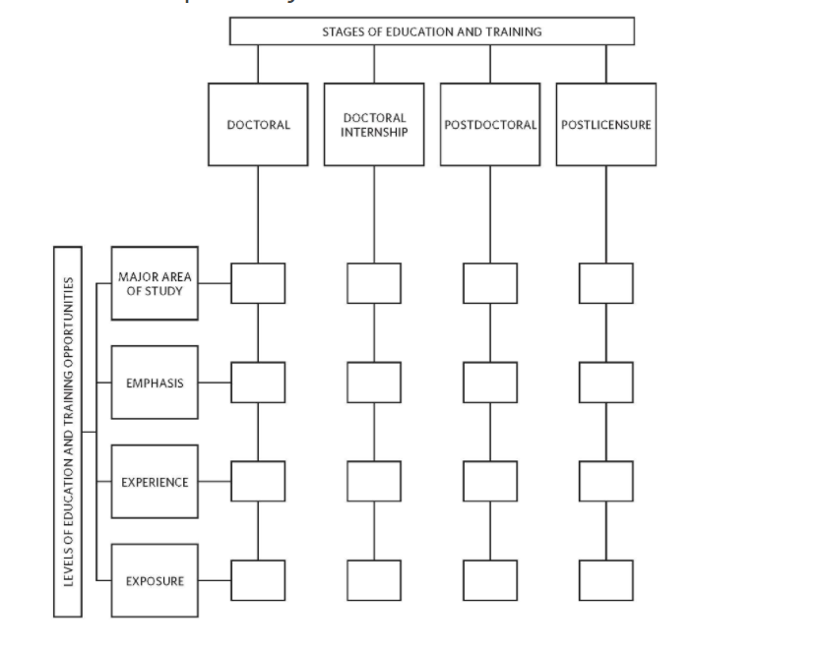
Taxonomy
Anything other areas of “specialized” practice (e.g. populations) should be referred to as “focus”

Slide 8
Petition Criteria
I. Administrative Organizations – sufficient systems and structures to assure organized development (*basically requires specialty council)
II. Public Need for Specialty Practice – responsive to identifiable public needs
III. Diversity – recognizes importance of cultural and individual differences and diversity
IV. Distinctiveness -differs from other recognized specialties in its body of specialized scientific knowledge and professional application
V. Advanced Scientific and Theoretical Preparation -requires advanced, specialty-specific scientific knowledge (in addition to a shared core of knowledge, skills and attitudes required for all practitioners)
VII. Advanced Preparation in the Parameters of Practice - advanced didactic and experiential preparation that provides the basis for services with respect to the essential parameters of practice

Slide 9
Petition Criteria
VII. Structures and Models of Education and Training in the Specialty - structures and models to implement the education and training sequence (Education and Training Guidelines)
VIII. Continuing Professional Development and Continuing Education - provides its practitioners a broad range of regularly scheduled opportunities for continuing professional development in the specialty practice and assesses the acquisition of knowledge and skills
IX. Effectiveness – demonstrates effectiveness of service provision with research evidence
X. Quality Improvement - promotes ongoing investigations and procedures to develop further the quality and utility of its knowledge, skills and services
XI. Guidelines for Specialty Service Delivery - has developed and disseminated guidelines for practice in the specialty (Practice Guidelines)
XII. Provider Identification and Evaluation - recognizes the public benefits of developing sound methods for permitting individual practitioners to secure an evaluation of their knowledge and skill and to be identified as meeting the qualifications for competent practice in the specialty (ABPP Board Certification)

Slide 10
Essential Elements of a Successful Petition
Strong literature base as evidenced by current, high-quality/high-impact, peer reviewed references
Demonstrated distinctiveness in theory and practice
Established competencies

Slide 11
What? Why? How?
GPGP Specialty Council Strategic Plan
Objective | Action(s)
1. Assist training programs to review for the specialty | Develop tools for program reviews (doctoral, internship, postdoc) Distribute to programs
2. Increase visibility of specialty | a. Conference presentations (APA, AGPA, webinars, etc., journal articles, Div 49’s website, newsletter)
3. Increase # of affiliated organizations | a. Identity and invite organizations (e.g., AMHCA)
4. Resubmission tasks | Compile citations and abstracts: studies/articles; conference pres; webinars; etc. Publish Education & Training Guidelines and update for resub Publish Clinical Guidelines and update for resub
5. GPGP Specialty Council | a. Set up archives

