Slide 1
Rehab
Psychology
Rehabilitation Psychology
William Stiers, PhD., ABPP (RP)
2013

Slide 2
What is Rehab Psychology?
Rehabilitation Psychologists help people with disabilities and chronic health conditions to maximize their health, independence, function, and social participation

Slide 3
Rehab Psychologists treat people with many types of injuries and illnesses, including:
  spinal cord injury
  traumatic brain injury
  stroke
  limb amputation
  burn injury
  chronic pain
  cancer
  multiple sclerosis

Slide 4


Slide 5


Slide 6
Disability is an interaction among three different factors:

Slide 7
The Person
physical ability, skills, motivation
The Task
type of activity (physical, cognitive, emotional)
The Environment
physical, social

Slide 8
For example, a person in a wheelchair may have…
difficulty with stairs, but not computers
more difficulty in a physical
environment without elevators and automatic doors
more difficulty in a social
environment where people are biased against persons with disability

Slide 9
Persons with disability can be helped by…
increasing their abilities, skills, and motivation
modifying tasks to fit their abilities
changing the physical and social environment to be more accessible

Slide 10


Slide 11


Slide 12
History
Rehab psychology began in the 1940s, during the time of World War II, when large numbers of injured military personnel were returning from war – now, there are many wounded military personnel again
Rehab psychologists study how people react to disability, and how to help people with disability participate in usual activities in their families and neighborhoods, at school and work, and in recreation

Slide 13


Slide 14


Slide 15
Importance
Almost 20% of Americans (56.7 million people) have a disability, with almost 13% (38.3 million people) having a severe disability
About 2 in every 7 U.S. families (29%) have at least one family member with a disability

Slide 16
Type of Work
Rehab Psychologists work in private practice, hospitals, clinics, rehab facilities, long-term care facilities, schools, and community agencies, including civilian, military, and veterans’ facilities
Rehab psychologists may treat patients and families, do research, teach, and consult to private and government agencies

Slide 17


Slide 18
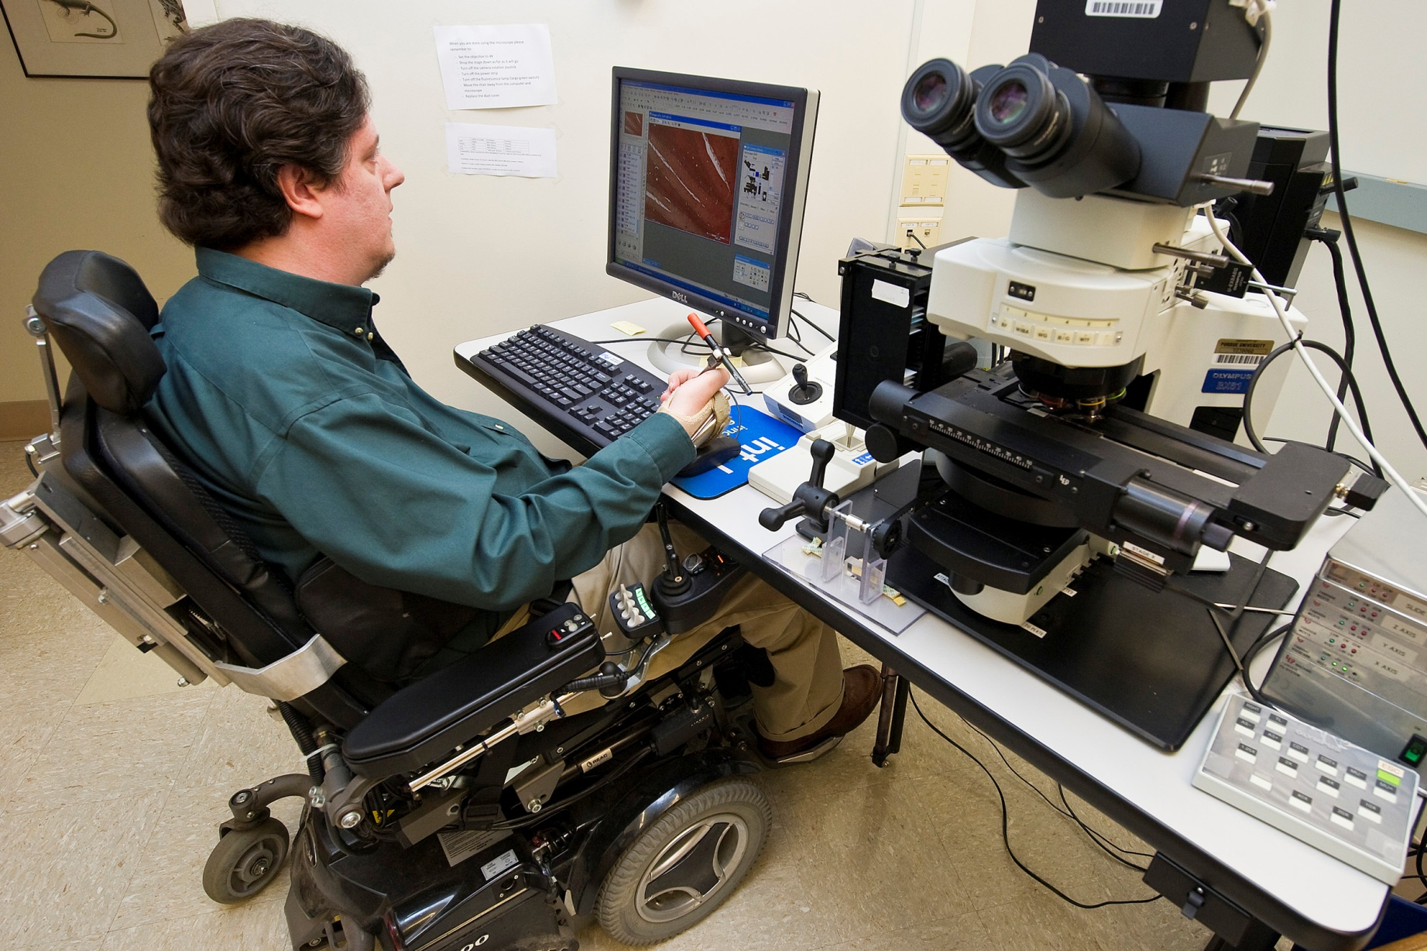

Slide 19
Conclusions
Rehabilitation Psychologists help people of all different abilities participate in their families and communities

Slide 20


Slide 21


Slide 22
Resources
http://www.div22.org

